Slide 1
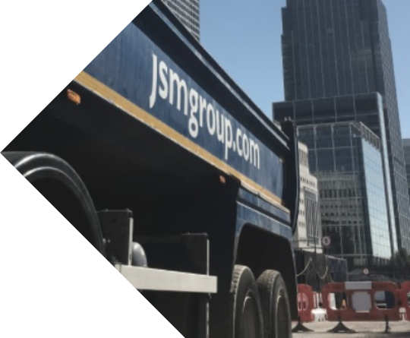

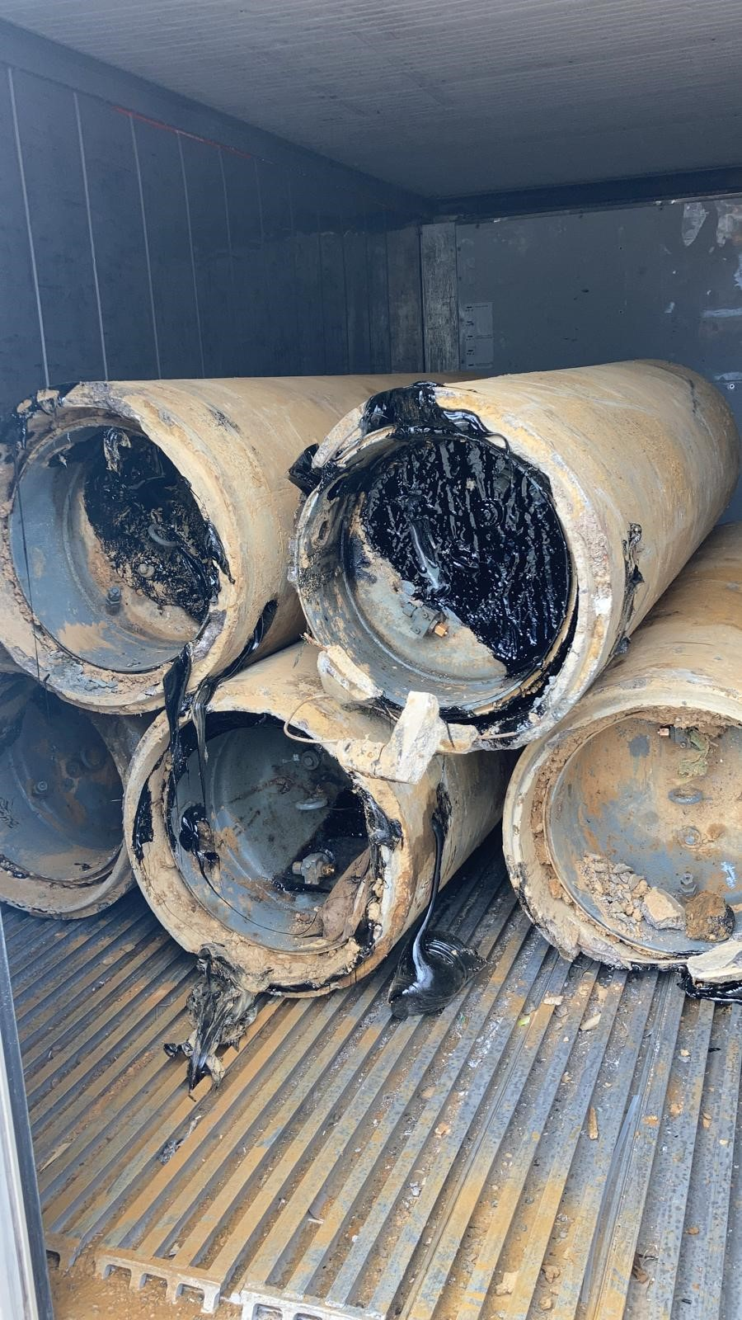
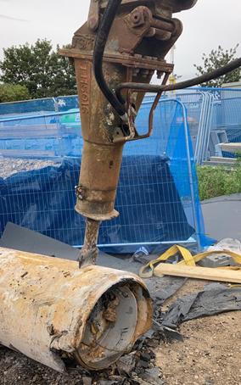
Good Practice
Case Study
  Freezing oil tanks for improved waste segregation - Beddington to Rowdown Cable Decommissioning
Waste segregation and increased recycling quantities were gained by freezing oil tanks to separate metal, concrete liner and bitumen compound filler materials on behalf of National Grid.
  The challenge
  Part of the scope of works for the Beddington to Rowdown Cable Decommissioning project in South Croydon included the removal of 81 oil tanks. During the planning stages of the project JSM suggested the use of a freezer container to improve programme durations, waste segregation and recycling of decommissioned oil tanks to the client National Grid and the proposal was accepted.
  The Solution
  JSM are Principal Contractor and Designer for the Beddington to Rowdown Cable Decommissioning Project.
  JSM applied an innovation of freezing the tanks to easily remove the sticky Bitumen compound infill from the tank spun-concrete liners which is a much cleaner safer way of separating the materials over the traditional heating of filler compound methods.
Project Fact File:
Beddington to Rowdown Cable Decommissioning
Location: South Croydon
Cable Decommissioning and removal, oil tank removal, oil purging works, vegetation management, cooling station decommissioning works to strip out mechanical and electrical equipment.
  Process and Benefits
The JSM method enables all oil tank materials (oil, metal, concrete liner and bitumen compound infill) to be separated, once the waste oil has been drained and segregated for recycling. The process stages were;
Purge oil from oil tank using nitrogen and segregate for recycling
Remove oil tanks via Non-Intrusive Tank Extraction (NITE)
Store oil tanks in freezer container for 24 hours+
Use specially designed machine breaker to separate concrete from infill
Once bitumen and concrete is removed, tap fitted and excess oil drained from tanks to ensure thorough oil removal
Segregate waste types in secure containers and transfer to recycling facilities.
Obtain hazardous waste and waste transfer notes and include waste quantities in NG, SCIP reporting.
All waste materials can be safely separated for recycling (metal oil tanks, concrete liner and bitumen compound filler)
NITE and Non-Intrusive Cable Extraction (NICE) have been fully developed by JSM, successfully trialled and are currently delivering projects in the UK. JSM’s aim is for NICE and NITE to become recognised as best practice within the EHV T&D sector for this type of cable decommissioning and/or replacement schemes.
“Having witnessed the difficulties of separating the bitumen compounds from oil tanks and EHV joints in the past , we decided there must be an easier, cleaner way of doing this. Freezing the bitumen compound allows it to harden and crumble into dust when being removed rather than run or drip uncontrollably creating an unsightly mess and difficulty in recovery. This innovative process has proven to be user friendly, cleaner for the environment and more cost effective over traditional methods”.
John Fitzgerald, JSM Senior Operations Manager – Power
        For further information please contact: John Fitzgerald
        +44 07710 325181 john.fitzgerald@jsmgroup.com

