Slide 1
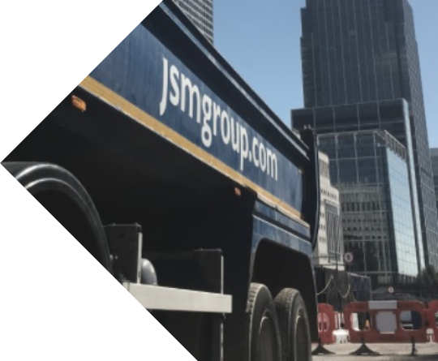

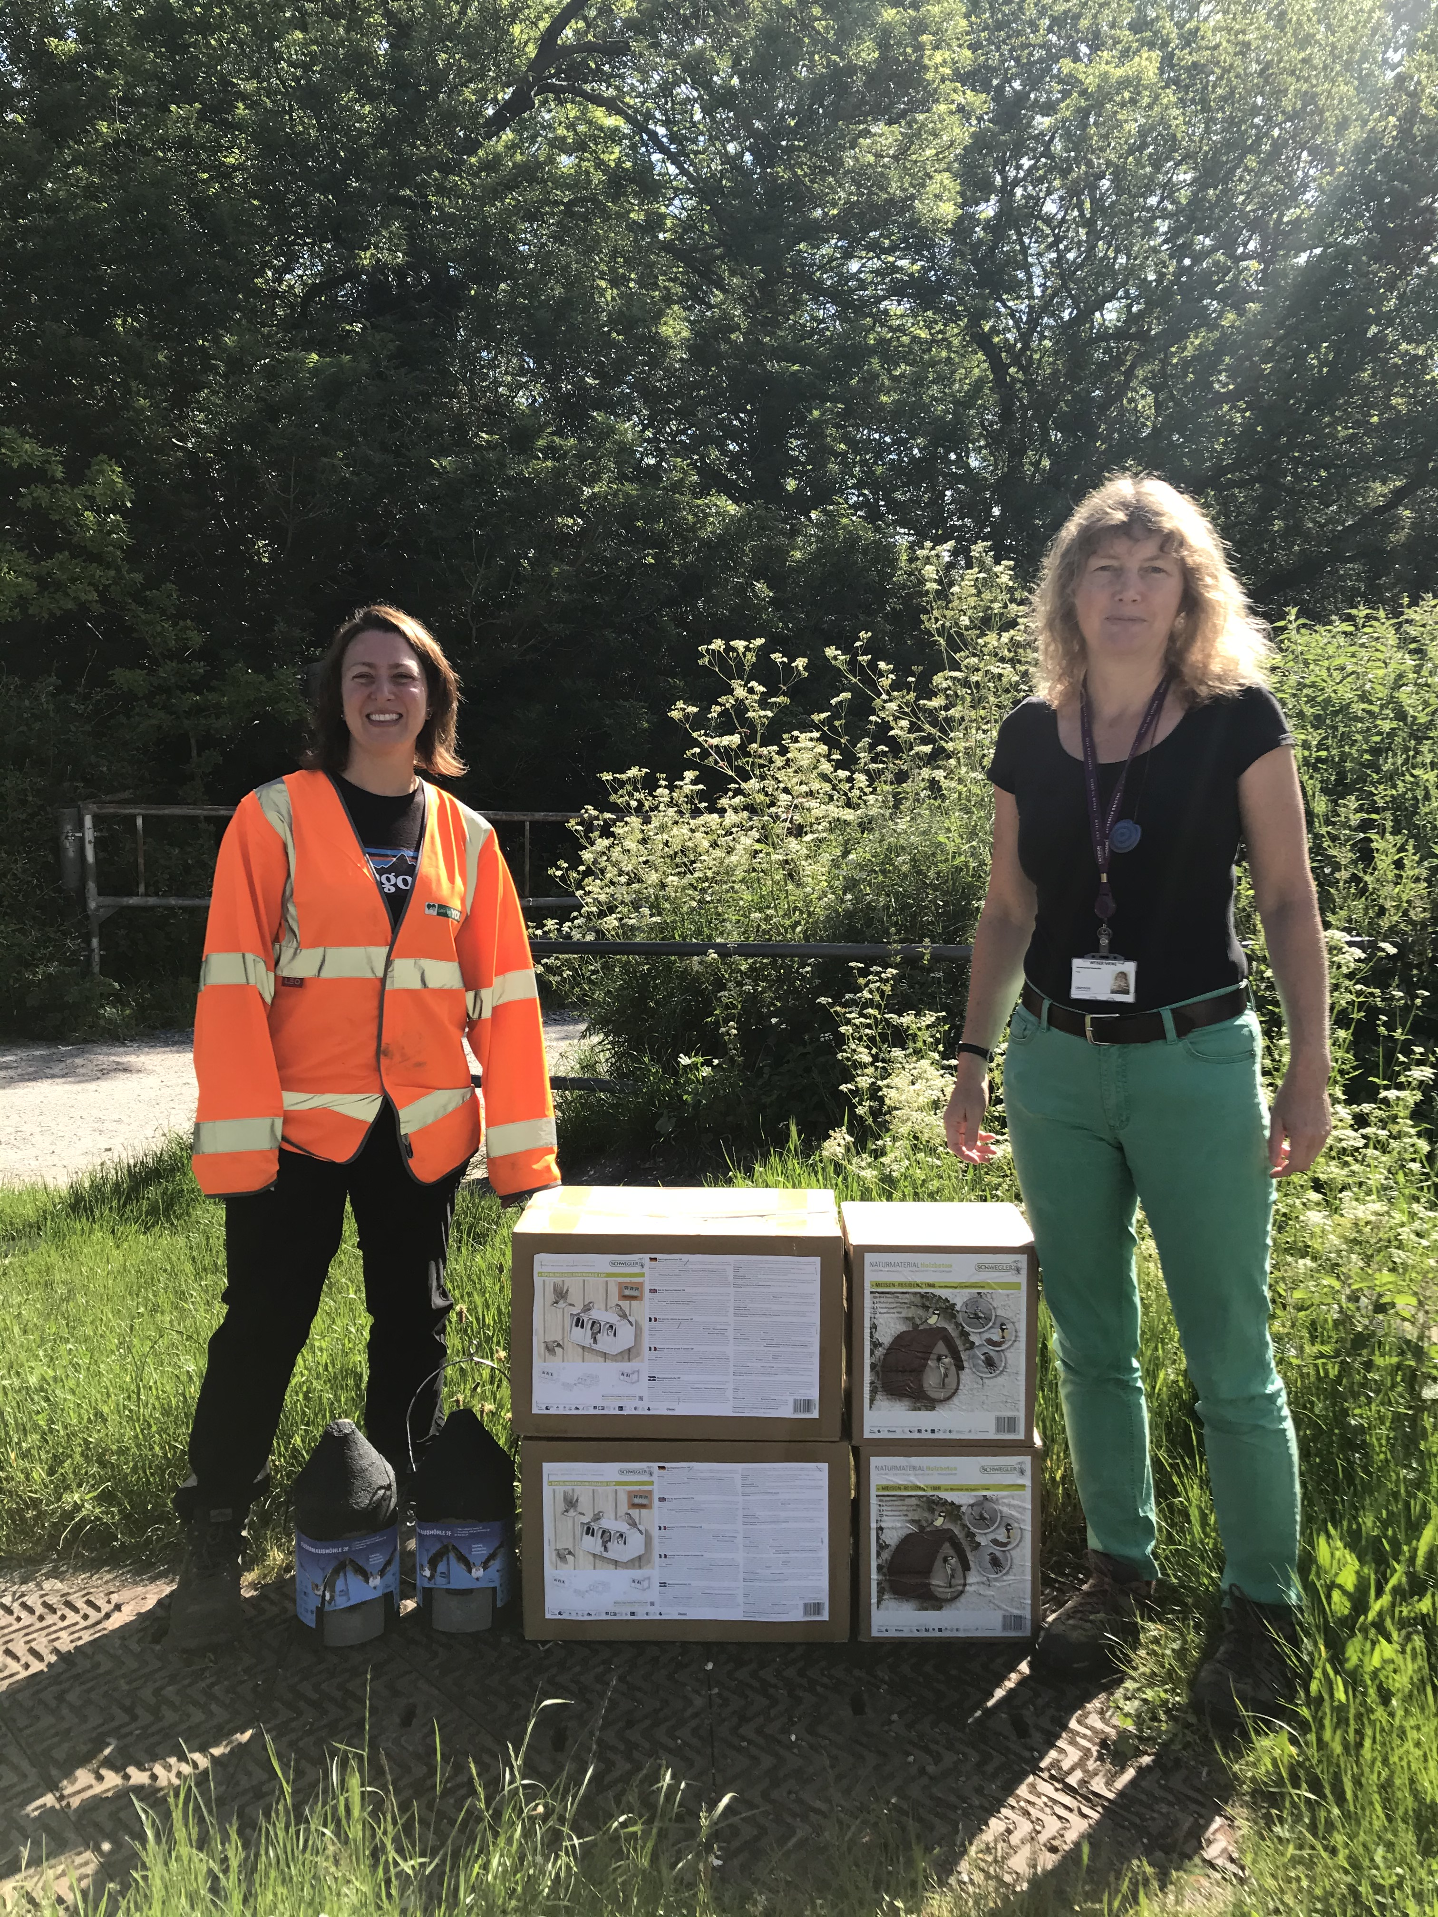
Good Practice
Case Study
  Biodiversity Opportunities, donation of Bird nesting and Bat roosting boxes
Biodiversity Opportunities were sought through donation of Bird nesting and Bat roosting boxes for use on local wildlife sites.
  The challenge
  In the UK, protected species include Nesting Birds and Bats (18 species of bats are found in the UK, 17 of which are known to be breeding here). Official data shows that the UK’s native birds have declined by 11% since 1970 primarily due to intensive agriculture. Bat populations have suffered severe declines during the past century, due to habitat losses, destruction of roost sites and changes in agricultural practices, which have reduced the number and diversity of their insect prey.
  The Solution
  JSM (Principal Contractor) for the Beddington to Rowdown Cable Removal project donated four bird nesting boxes and two bat roosting boxes to the Community Conservation Partnership Team at Croydon Council. The boxes will be applied at Addington Hills, Wandle Park or South Norwood Lake.
Project Fact File:
Beddington to Rowdown Cable Removal
South Croydon
Cable Decommissioning and removal, oil purging works, vegetation management, cooling station works to strip out mechanical and electrical equipment.
  Challenges Faced & Lessons Learnt
  Contacts had been established with Croydon officers during the consenting stages for vegetation management required to enable the works. As a goodwill measure, the boxes were offered by JSM to Croydon to benefit the wildlife in South Croydon. Costs of the biodiversity opportunity boxes totaled £340. National Grid have agreed to £10,000 of street tree funding to Croydon which will be used as part of a Grant application for the Local Authority Treescapes Grant or used to plant 23 new trees. Wildflower planting is currently being considered in the open spaces.
  The Benefits
  Use of the bird and bat boxes will be monitored by licenced members of the London Bat Group once installation has been undertaken. This opportunity has led to collaboration and development of relationships between National Grid, JSM and Croydon Council and protected wildlife will benefit in South Croydon.
Specification of bird and bat boxes;
  Schwegler design: 1MR for a range of common garden birds Schwegler design: 1SP sparrow terrace. 2F Schwegler bat box (general purpose).
“This kind donation will enable us to replace some of the old wooden boxes with the new Schwelgler boxes. The sparrow terrace will make a great addition in Wandle Park, which has a thriving sparrow population.”
Meike Weiser, Croydon’s Community Conservation Partnership Officer
        For further information please contact:
Claire Parsons (Environmental Manager)
+44 07702 972684
claireparsons@jsmgroup.com

