Slide 1


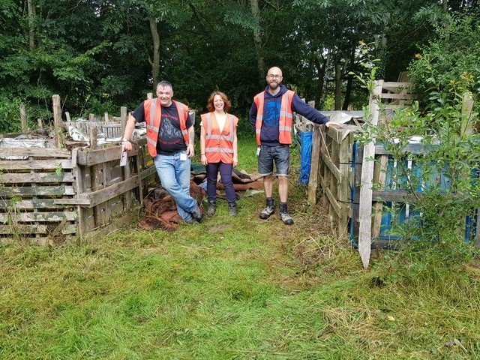
Good Practice
Case Study
  One Planet Action Plan – Little Havens Hospice Volunteering Work
JSM’s Social Value was increased through corporate volunteering at Little Havens Children’s Hospice in Rayleigh, Essex.
  The challenge
  Little Havens is a children’s hospice set in beautiful meadowland in Rayleigh, Essex. They are a nursing-led hospice with a mixture of qualified paediatric nurses, healthcare support staff and trained volunteers
  They care for children and young people up to the age of 25 from Essex and the surrounding boroughs who have been diagnosed with a complex or incurable condition. Support is also offered to the family. They offer overnight respite breaks, emergency stays and care at the end of a child’s life.
  Support given
  On 28th July 2021, JSM provided a volunteer team to support the hospice by undertaking gardening work to improve the garden facilities and open spaces that are used to provide a play area and relaxation for the children and their families.
Project Fact File:
JSM’s One Planet Action Plan – adding Social Value towards Land and Nature and Community targets
Little Havens Childrens Hospice, Rayleigh, Essex
JSM undertook garden maintenance work; weeding, scrub clearance and rotation of the compost area.
  Challenges Faced & Lessons Learnt
  Covid-19 has impacted the various fundraising activities that the Hospice would otherwise regularly hold and restrictions have meant that the usual garden maintenance regime has not been able to be undertaken.
  The Benefits
  This opportunity has led to collaboration and development of relationships between Havens Hospice and JSM and local communities of Essex and London who use the Hospice will benefit. The volunteering counts towards JSM’s One Planet Action Plan – adding Social Value towards our Land and Nature and Community targets.
Insert good quality and relevant photos or other visual aids (e.g. diagrams or illustrations) to accompany the text.
For more information on Havens Hospice, please see;
https://www.havenshospices.org.uk/childrens-and-young-peoples-care/little-havens/
‘It was great to have the team from JSM volunteer at Little Havens. We usually have three corporate groups a week come down to the hospice to help maintain our beautiful gardens but due to COVID19 this did not happen for nearly 18 months. Their hard work was hugely appreciated and they really helped make a difference to the Little Havens Gardens’.
Lydia Plews, Senior Business Development Officer, Havens Hospice.
        For further information or to get involved in future projects, please contact:
Claire Parsons (Environmental Manager)
+44 07702 972684
claireparsons@jsmgroup.com

