Slide 1
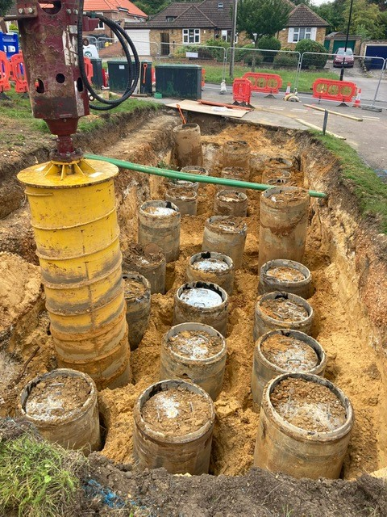
Good Practice
Case Study
Use of Non-Intrusive Tank Extraction
for Beddington to Rowdown Cable Decommissioning
Various environmental, cost and time efficiencies were gained through the use of Non-Intrusive Tank Extraction on behalf of National Grid.
The challenge
Part of the scope of works for the Beddington to Rowdown Decommissioning project in South Croydon included the removal of 81 oil tanks. During the planning stages of the project JSM suggested the use of Non-Intrusive Tank Extraction (NITE) to offer various efficiencies to the client National Grid and the proposal was accepted.
The Solution
The JSM method enables all the excavation and removal works to be carried out from ground level mitigating the need for large, deep excavations and substantial temporary works which, in turn means a safer method. Once the top of the tank have been exposed and oil feeder pipes removed then everything is undertaken from above ground very quickly.
The technique represents a huge saving in terms of both time and cost whilst significantly reducing requirements for manual handling, confined space working, operational safety and environmental risk.
Project Fact File:
Beddington to Rowdown Cable Decommissioning
Location: South Croydon
Cable Decommissioning and removal, oil tank removal, oil purging works, vegetation management, cooling station decommissioning works to strip out mechanical and electrical equipment.
The benefits include;
80% less excavating over traditional oil tank removal methods.
80% less muck/waste going to landfill over traditional removal methods.
80% less primary material required for backfilling over traditional removal methods.
No need for operatives to enter a deep excavation or to work at height.
No need for heavy duty sheet piling as would be required for traditional 5m deep excavations
Less plant movements – less risk of incidents
Less Environmental impact and 80% savings on carbon footprint of task.
80% quicker than traditional methods
All waste materials can be safely separated for recycling (metal oil tanks, concrete liner, and pitch tar filler)
JSM also applied an innovation of freezing the tanks to easily remove the pitch tar infill from the tank spun-concrete liners which is a much cleaner safer way of separating the materials over the traditional heating of filler tar methods.
NITE and Non-Intrusive Cable Extraction (NICE) have been fully developed by JSM, successfully trialled and are currently delivering projects in the UK. JSM’s aim is for NICE and NITE to become recognised as best practice within the EHV T&D sector for this type of cable decommissioning and/or replacement schemes.
“Following some difficulties experienced by our clients during historical oil tank removal works, JSM were approached by Industry leaders and tasked with developing a novel method to challenge and change the old traditional methods of recovering these deeply buried Cable oil tanks, normally placed at 5m deep. This NITE concept was designed, developed, field tested and successfully deployed to mitigate inherent risks with deep excavations and associated lifting operations on constricted sites. I feel honoured that we have made very positive changes to the old norm and that we are innovating in the right direction to keep our workers safe and protecting the environment at the same time! It’s a win, win for everybody.”
John Fitzgerald, JSM Senior Operations Manager - Power

